Slide 1
Septic Systems and the Home
Notes:
Danny: welcome the class
- The Metropolitan North Georgia Water Planning District is partnering with the Department of Public Health and metro Atlanta water utilities to educate real estate professionals and the public on septic systems and water quality issues.
- We have created this training because we recognize that the public benefits from working with real estate professionals who can explain septic systems and water quality issues that affect their properties, and who can provide reliable resources to them.

Slide 2
Notes:
Danny: After speaker introductions, ask the class to indicate their level of familiarity with septic systems
Have you ever lived on septic?
How often do you sell a home on septic?
What is the number one question you get from home buyers about septic?
Note any interesting comments or myths that you may want to address later in the presentation.

Slide 3
What is the Metro Water District?
Notes:
Danny: Brief overview over the next few slides of the Metro Water District then turn it over to Alan for an overview of DPH and to begin the basics on septic systems.
Some points you may consider in these slides:
Unlike most large cities that were built around access to water, Atlanta began as a transportation hub.
It has the highest elevation of all major cities east of the Mississippi River.
The region is located at the headwaters of six major river basins and three river systems, which represent the smallest watershed providing a major portion of water supply for any metropolitan area in the country.
Our region sits on a bedrock of granite, so ground water is not an option
Over 70% of our water supply in metro Atlanta comes from Lake Lanier and the Chattahoochee River.

Slide 4
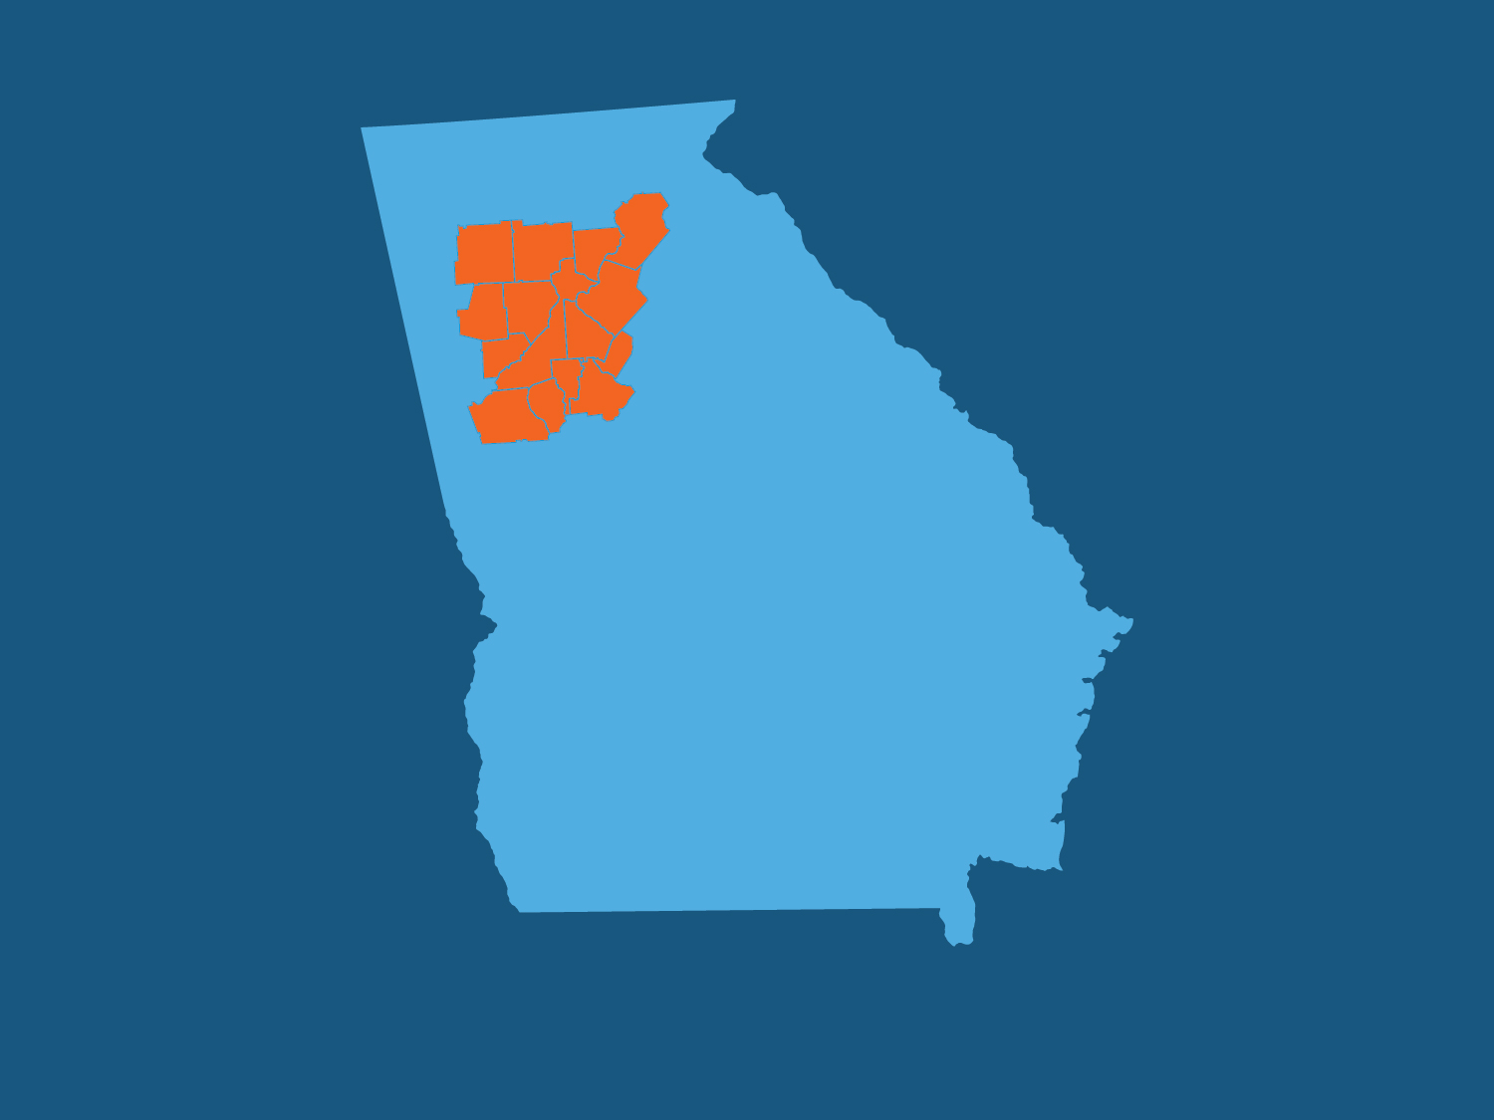
15
The District consists of 15 Counties…

Slide 5
95
…and 95 Cities

Slide 6
5.7M
With 5.7 million people in the Metropolitan Statistical Area…

Slide 7
9
…Metro Atlanta is currently the 9th largest region in the US…

Slide 8
450,000
…and has an estimated 450,000 septic systems
Notes:
Danny: We estimate about half a million homes in the Metro Water District on septic systems. Many of our paper records are limited with the older systems installed, but we estimated that:
DeKalb County has about 22,000 septic systems
Rockdale County has over 15,000 septic systems, or about half of their homes are on septic
Gwinnett County has the largest number of septic systems in our region. DPH estimates over 65,000 systems but Gwinnett County has reported up to 100,000 systems.

Slide 9
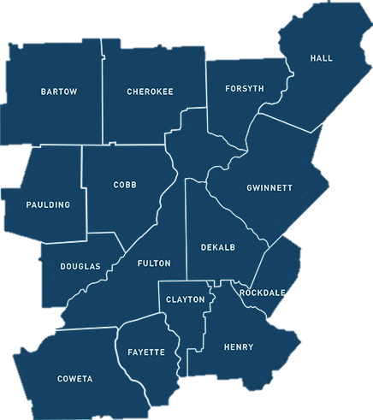
Regional Water Resources Plan
Metro Water District
develops the regional plan
Local governments are responsible for implementing the plan
Georgia EPD approves the plan and enforces implementation via permits
Notes:
Explain the Plan and that there are measures
There are septic management action items in the regional plans that are the responsibility of the local governments
Today we will discuss the action items pertaining to septic in more detail

Slide 10
Water issues for the home water quality
Notes:
Ben:
Maintaining a septic system is good for the environment and we saw the potential pollution that can be created when a homeowner does not maintain their system.
Now we are going to phase into water quality and water conservation around the home
25 minutes for this section

Slide 11
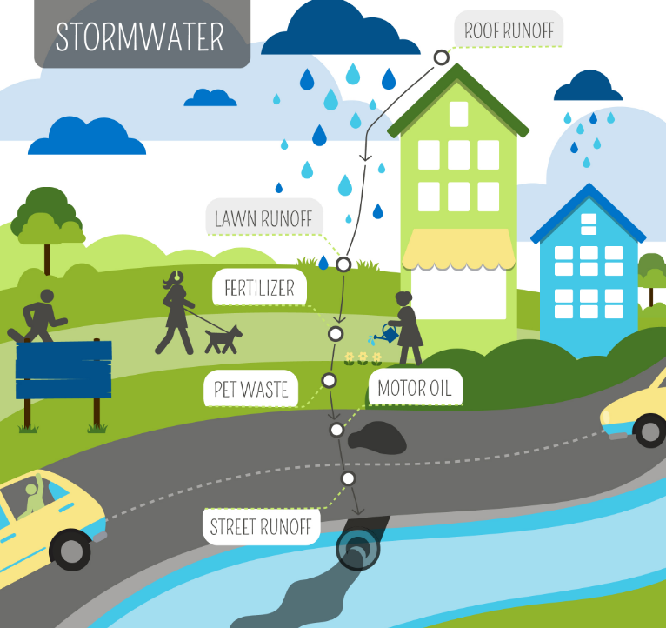
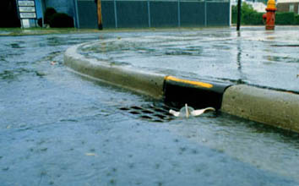
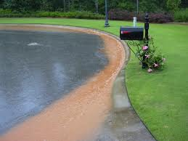
Impact of Development on Water
Notes:
Ben:
What is the water cycle? – It is the natural cycle of the water we have on our planet. Basically, water precipitates in the form of rain or what we call stormwater and some is absorbed into the ground while the rest runs down streams into lakes and oceans, evaporates and precipitates again starting the cycle over.
However, when you introduce development and urbanization the cycle is altered. Development increases impervious cover (roofs, paved roads, parking lots etc.) and concentrates human activity which results in decreased ground water recharge and increased stormwater contact with pollutants. This stormwater picks up pollution like fertilizers, pesticides, pet waste, motor oils/fluids, trash, dirt, bacteria and so forth. Additionally, water flows faster across impervious surface thereby increasing the velocity of water runoff which increases erosion and sedimentation once stormwater reaches natural features.
Stormwater pollution is considered nonpoint source pollution because it’s not from a single point, but from the entire watershed.
The Metro Water District, tries to prevent stormwater pollution by creating different ordinances and strategies for local governments in the metro Atlanta area. And of course we as the Fayette county government have our own stormwater ordinances that regulate construction and post construction stormwater as well as prevention of illicit discharges to the county stormwater system.

Slide 12
Water Quality
Local tree ordinances
Stream buffers
Stormwater utility
Floodplain management
Detention ponds
Notes:
Ben:
Let’s take a look at a few of these ordinances and practices that protect water quality by the local governments in the North Metro District.
Tree ordinances:
There are local tree ordinances in our region that you may already be familiar with.
The purpose of a tree ordinance is to facilitate the protection of trees and their replacement
Tree root system reduces soil erosion and stormwater runoff which decreases sedimentation problems and improves water quality
Trees enhance the natural function of streams and related buffers
Having an ordinance prevents clear cutting and ensures trees are properly replanted if a tree is lost
Advise your homeowners to contact the county arborist before removing trees on their property (Environmental Management for Fayette County)
Trees can also add aesthetic and economic value to properties
Stream Buffers:
The state of Georgia requires that a 25-foot buffer be maintained between the edge of a stream and any new development.
The local governments in the 15 county metro Atlanta area require an additional 50 feet of buffer (for a total of 75 feet).
Vegetated buffers near streams provide for filtration of storm water runoff, shade water in streams, and allow wildlife a critical corridor for moving throughout an ecosystem.
Please contact the county if a homeowner has any proposed development in the buffer. Fayette County has much larger setbacks and buffers than many counties and is property specific.
Stormwater Utility Fee:
The stormwater utility fee was removed here in Fayette County, but In DeKalb County Stormwater a Utility fee is collected on the water and sewer bills to address stormwater drainage issues and concerns.
The fees are assessed based on the demand placed on the stormwater drainage system by their property’s runoff from impervious surfaces.
The Stormwater Utility fees are used to sustain and improve the County's stormwater drainage system.
This is accomplished by repairing, upgrading, and performing preventative maintenance on structures such as catch basins, pipes, culverts, detention ponds, and headwalls.
While there is no Stormwater Utility in the Unincorporated Fayette County, we utilize SPLOST for stormwater system maintenance
Floodplain:
There are also local floodplain management and flood damage prevention ordinances in our region
These local government ordinances minimize future flooding impacts during the land development process
There are requirements when building in a floodplain for both residential and non-residential
Many of our communities participate in the FEMA Community Rating System and therefore residents are eligible for discounted flood insurance
Protecting floodplains also protect property and can increase aesthetic and economic value as well as provide community opportunities for recreation
Detention ponds:
Detention ponds on residential/commercial properties are typically the responsibility of the property owner or HOA to maintain and upkeep, not the local government; however, there are exceptions out there.
When maintained properly, detention ponds can be an effective best management practice for managing stormwater runoff from paved surfaces and development.
They slow the release of stormwater into local streams and helps to filter out some of the pollutants
There are different maintenance requirements for ponds, so you may advise homeowners to contact us at Environmental Management and hire a third party for maintenance.

Slide 13
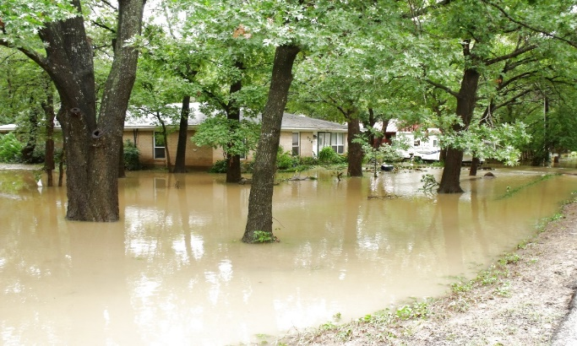
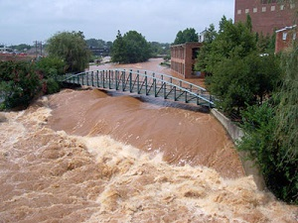
Floodplains
Notes:
Ben
Ensuring an understanding of the floodplain on a property is very important to relay to a potential buyer as it a safety concern and can affect septic installation.
Walk through the graphic and explain the chances of flooding during a 30 year mortgage
Ask if they are familiar with the flood maps (FEMA) and if they have any questions about them map.georgiadfirm.com (enter address and generate report to describe flood risk)
May want to mention the community rating system (CRS) and that it may reduce flood insurance costs (provide printed handouts)

Slide 14
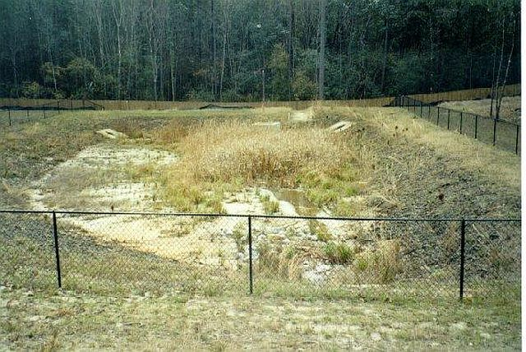
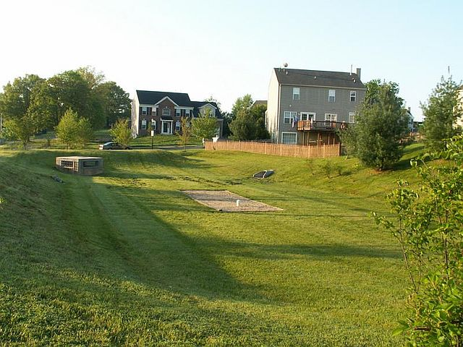
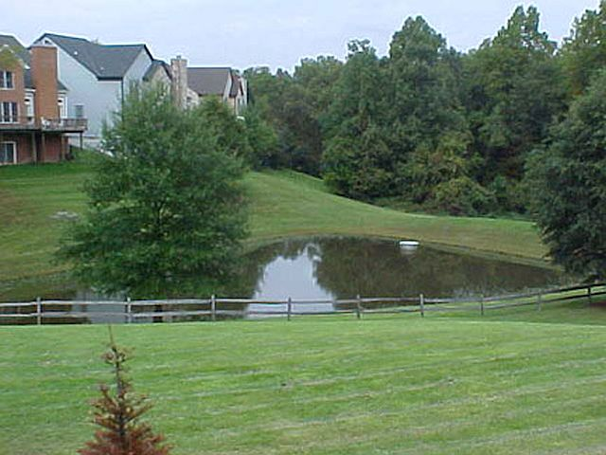
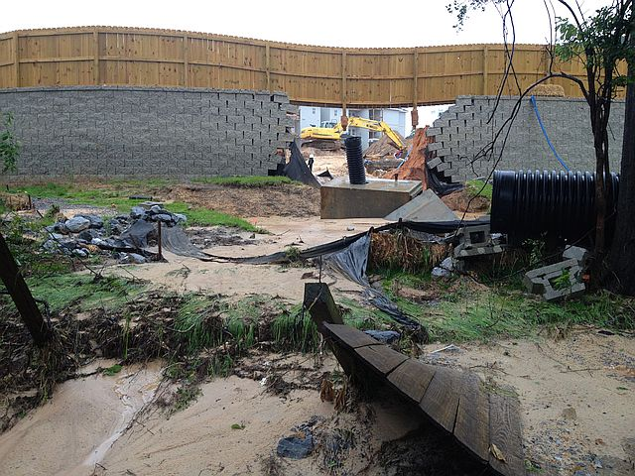
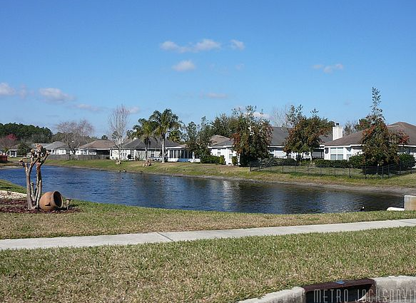
Stormwater Ponds
Notes:
Ben
Stormwater ponds/systems – intend to retain water on a development to ensure the pre and post construction discharge of water is same or similar and provide water quality benefit through reduction of pollutant discharge.
To ensure proper function and prevent failure maintenance is required – vegetation management (mowing, weed eating, cutting trees) but also removal of sediment & trash, regrassing, stabilizing erosion, etc.)
Fayette County post construction ordinance requires Operation and Maintenance Agreements along with Maintenance Plans for the stormwater ponds/systems be established on new development. Typically the developer creates the agreement and maintains the pond until construction is complete then the stormwater pond property is transferred to a new property owner (typically an HOA) and the maintenance agreement runs with the property owner
Questions?

Slide 15
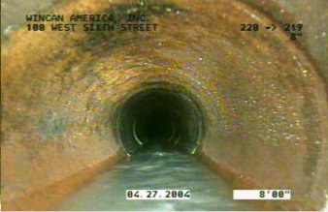
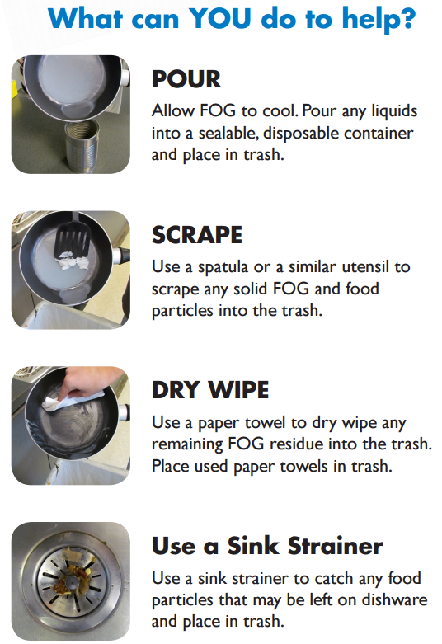
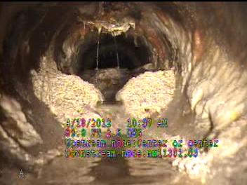
Fats, Oils and Grease
Notes:
Ben:
Now let’s move onto Fats, Oils and Grease, or as we like to call it: FOG
It may seem like it’s not a big deal to pour a little bit of oil down the drain or tossing meat scraps in the garbage disposal, but every bit adds up and can create major clogs (including septic backup)!
FOG is a problem for everyone – regardless if the home is on septic or sewer!
FOG enters the sewer system or your septic system through your plumbing, by pouring it down the drain, a toilet or using a garbage disposal to dispose of food scraps.
FOG, food scraps, and used cooking oils should be thrown in the trash, not down the drain or the garbage disposal.
FOG is a by-product of cooking and comes from not only cooking oils, animal fat and grease, but also from dairy products, mayonnaise, salad dressings, marinades and butter or margarine!
Transition to Environmental Health

Slide 16
Department of Public Health Local Overview
Purpose: reducing the risk of illness and injury related to interactions between people and their environment
The purview of Environmental Health Division includes:
- Body crafting
- Food safety
- Hotels and Motels
- Lead poisoning prevention
- Mosquitos
- Radon
- Septic systems
- Swimming pool, beach and spa
Notes:
DPH: provide overview of DPH at the county level and the septic system program.
The Department of Public Health regulates and monitors residential and commercial on-site sewage management systems to minimize the risk of health problems.
The septic system program reviews plans, analyzes soil reports and conducts site evaluations
It also approves and issues permits, evaluates new and repaired septic systems and investigates complaints of failing systems.
Furthermore the program issues permits for septage haulers and inspects their vehicles for compliance.
You may not know this, but the Environmental Health Division also covers many other areas (please give a brief summary of your work in these other areas)

Slide 17
Basics of septic systems
Notes:
DPH: According to the EPA, more than one in five households in the US dispose of wastewater through septic systems. In this first portion of the course, we will go through the basics of septic systems and how they work.
30 minutes to cover this section

Slide 18
Basic Information about Septic Tanks and Usage
Underground wastewater treatment structure
Treats wastewater from household produced by bathrooms, kitchen, dishwasher and laundry
It is the end point of a home’s plumbing system, if not on municipal sewer
Notes:
DPH:
The water from washing machines, baths, toilets, and other uses must go somewhere. That is where your septic system comes into play. It is your personal wastewater treatment system.
If designed, installed, and maintained properly, a septic system can be a cost-effective, efficient way of disposing of wastewater on your property.

Slide 19
Components of a Septic System
Notes:
DPH: (this slide is a septic system in a nutshell, the next slide goes into more detail)
Here are the septic system basics:
The septic tank is an underground watertight container built to receive sewage
The tank and lines are buried under the ground and help disperse the wastewater we create into the soil.
All water runs out of your house from one main drainage pipe into a septic tank.
A typical septic system consists of a septic tank and a drainfield, or soil absorption field.
The septic tank collects the solids and separates oils and grease from the wastewater.
The liquid wastewater then exits the tank into the drainfield

Slide 20
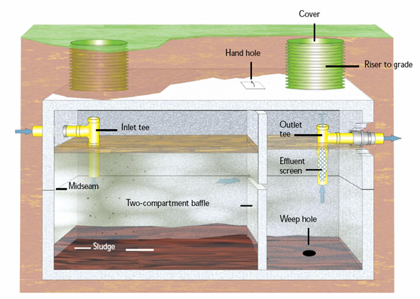
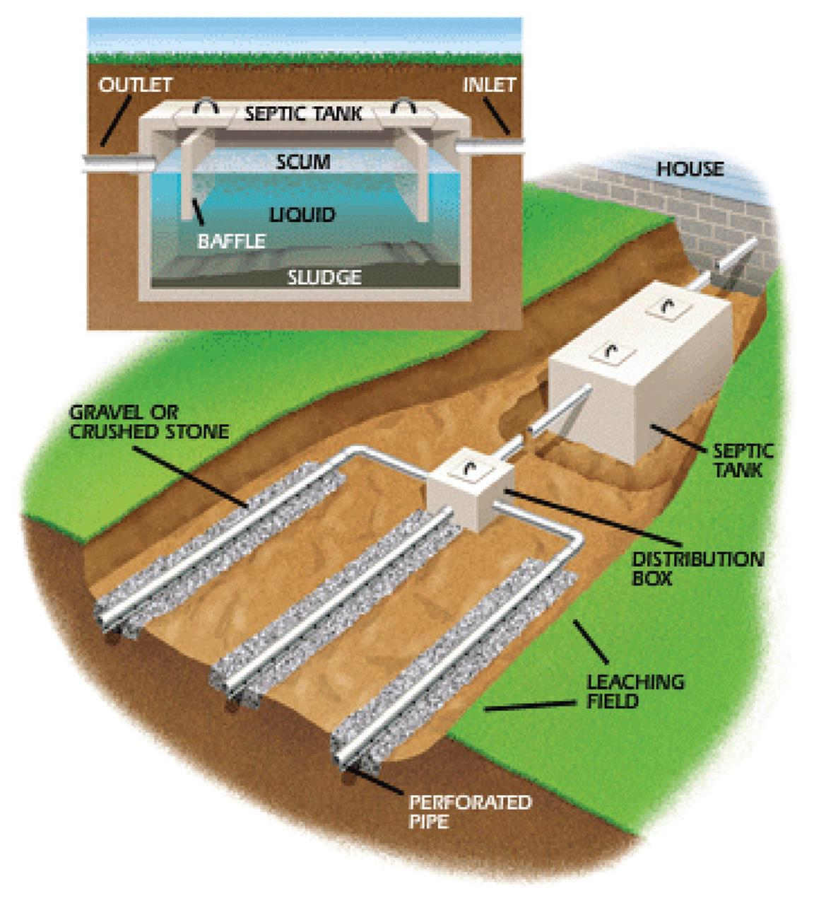
Components of a Septic System
Notes:
DPH: Now let’s dive in a little deeper.
The septic tank is a, water-tight container usually made of concrete, fiberglass or plastic.
Its job is to hold the wastewater long enough to allow solids to settle down to the bottom
This forms sludge at the bottom of the tank, while the oil and grease floats to the top as scum.
The liquid wastewater then exits the tank into the drainfield.
You may have heard of septic system backups in toilets or sinks or maybe the ground is soggy around the septic tank, this is caused by the drainfield being overloaded with too much liquid
Wastewater percolates into the soil, through a series of perforated pipes designed to slowly release the liquid and naturally removes harmful bacteria, viruses, and nutrients.
While typically designed to hold a minimum of 1,000 gallons of sewage, the size of the tank may vary depending upon the number of bedrooms and the use of a garbage disposal.

Slide 21
Notes:
DPH: Please explain that we will view a short module to illustrate how a septic system works and recap the basics of a septic system. The module is a click through and you can summarize each step. We have budgeted approximately 10 minutes for this.
Click image to connect to http://www.gbra.org/septic.swf - It will only open in Internet Explorer!
5 minutes to walk through module

Slide 22
How to Locate the Septic Tank
Did the previous owners leave a map?
Survey the yard
Follow the pipe
Don’t hesitate…
Call Environmental Health!
Notes:
DPH: Locating a septic can be easier than you think and doesn’t require a water dowser or diviner.
Here are some easy steps to take to make your buyers and sellers more aware.
Did the previous owners leave a map or any other helpful information?
Look at your yard. Are there any unexplainable low or high spots?
Follow the pipe! Look for the pipe that leaves the basement or crawl space and terminates in the yard.
Septic would be about 10 feet from the home about 12-18 inches deep
Or better yet, don’t hesitate just call Environmental Health. We may have the site plans if the system was installed after the 1960s.

Slide 23
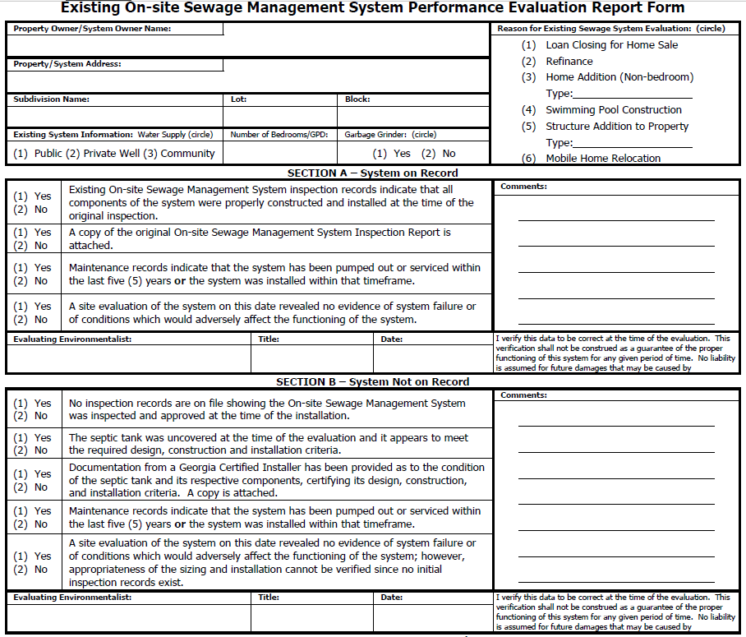
Notes:
Slide has been hidden
DPH: Please walk through the evaluation form. The class will have a handout.

Slide 24
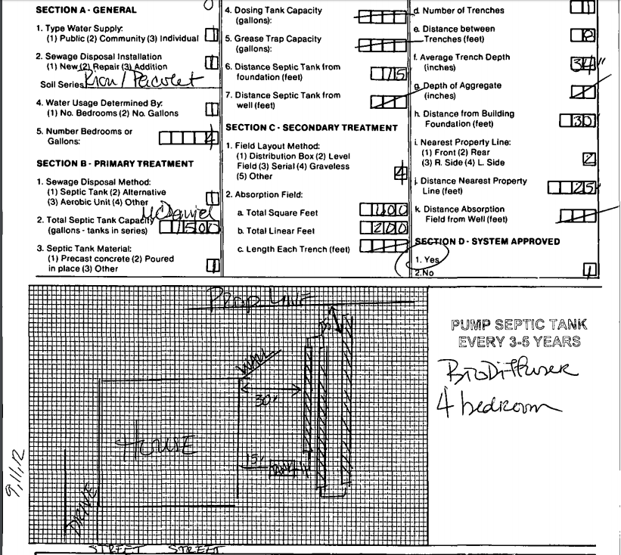
Septic System Records
Notes:
DPH: Please share and walk through these example records from a property in Gwinnett that may resemble what the realtor may find when helping the homeowner locate the septic tank records.

Slide 25
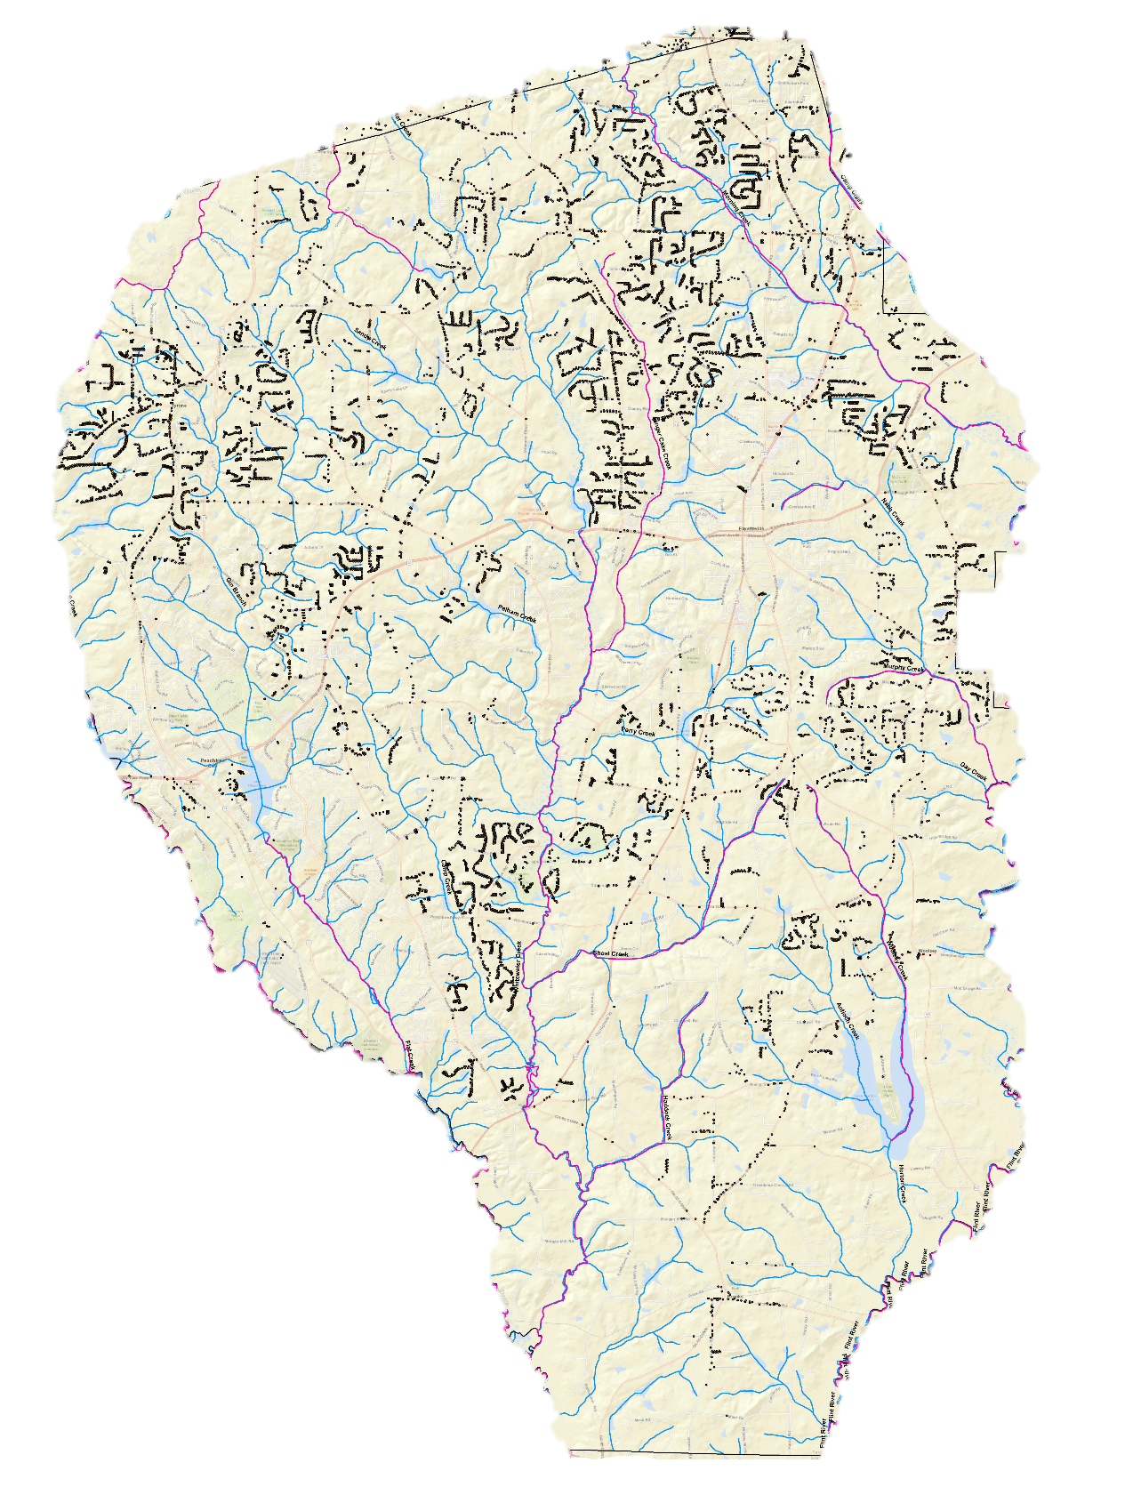
Fayette County Septic Tanks
Notes:
DPH: Please share and walk through this map of septic parcels in Fayette County.

Slide 26
Types of Septic Systems
Conventional Systems
Standard Gravity
Pressure Distribution
Alternative systems
Aerobic Treatment Unit (ATU)
Mound System
Sand Filter System
Other Systems (Proprietary)
Notes:
DPH: (please give a very brief overview of the types of septic systems; if there are any systems not found in GA, please don’t mention)
Conventional Systems
Gravity System: This is the basic or standard system, which uses gravity to move effluent through the septic tank and into the drainfield.
Pressure Distribution System: has a pump which distributes effluent throughout the drainfield at the same time. Used in most new systems because it makes better use of the entire drainfield.
Alternative Systems
Aerobic Treatment Unit (ATU): Uses oxygen to break down solids, producing cleaner wastewater than conventional types. Often used in environmentally sensitive areas where effluent requires more treatment before entering the drainfield.
Maintenance agreements are required for the first three years on alternative systems in Georgia.
Homeowners are encouraged to continue these agreements and maintain the system.
Mound System: Installed when minimal soil is available for treatment, drainfield is raised above ground level.
Mostly found in South GA
Sand Filter System: Has a sand filtering system and pump to treat and disburse effluent, used when minimal soil is available for treatment.
There are other proprietary systems available. (Alan, if you want to add anything here please do so.)

Slide 27
Buying and selling a home on septic
Notes:
Danny: Let’s transition to your roles of representing a buyer or seller with a home on septic. First, it’s important that you are aware that the home is on septic because it is the responsibility of the homeowner to maintain, repair, or replace all components of the septic system so that it will protect the environment and public health. But what if you are working with a client that is interested with a home and you don’t know if it’s on sewer or septic?
30 minutes on this section

Slide 28
How to Know if a House is on Septic
Seller’s Property Disclosure Statement
Water bill does not include a sewer charge
Home uses well water
Neighbors are on septic
Don’t hesitate…
Call Environmental Health or the local water/sewer provider
Notes:
Danny: We have heard many stories of homeowners that either assumed they were on sewer and were surprised to find out they had a septic system or they may have always assumed they were on septic, but actually were connected to sewer.
Here’s some tips on how to know if a house is on septic if the seller is unaware:
The water bill does not include a sewer charge
The neighbors are on septic
The home uses well water (you can know this if the waterline coming inside the home doesn’t have a meter on it)
And, again you can always call the local environmental health department for the septic records or call the local water and sewer department and ask if the home is on sewer.

Slide 29
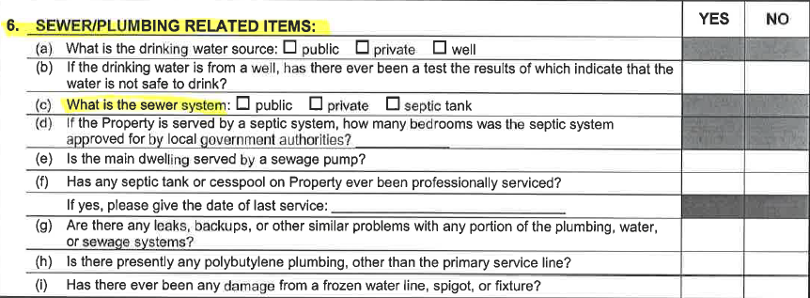
Seller’s Property Disclosure Statement
2016 Special Stipulations
Notes:
Danny: walk through the realtor documents
If you are representing the seller and now that you know that the home is on septic, you can now disclose this information properly on the Seller’s Property Disclosure Statement
Some of the information you are recording is:
what is the sewer system?
how many bedrooms was the system approved for?
has it been professionally serviced? what was the date of that service?
This is where you will indicate if it has been pumped out and had regular maintenance or repairs
Remember that if there was a repair, the permit would be on file with the local environmental health department
are there any leaks or backups with any of the plumbing, water or sewage?
A backup is a warning sign of a septic problem and we will address this in more detail after the break
Septic systems are also addressed in the Special Stipulations, page 4, SS 318
This refers to the lender required septic system clearance letter and may be required in some transactions based on the lender
Note that this is just asking for a visual inspection of the system and may note if there is a problem with water standing on the property above the septic tank, but it is not a full inspection of the system which can be performed by a state certified septic contractor

Slide 30
Myths of Septic Systems
Septic systems are just for rural areas
All septic systems fail and cause lots of problems
Maintenance costs too much money
The buyer will not know there is a problem until it’s too late
Notes:
Danny: address some of these common myths on the next two slides
Myth: Septic systems are just in rural areas.
- Actually septic systems are common in Georgia and can be found in urban and rural areas.
Myth: All septic systems fail and cause lots of problems. I want to avoid a home on septic.
- Just like your air conditioner, roof and electric wiring, septic systems are not made to last forever.
- This is a major component of your home and should be regularly maintained.
- Since 1990, all newly developed, non-sewered lots must have a soil analysis performed before permitting and has drastically reduced systems that fail prematurely.
Regular maintenance is only recommended every 3 – 5 years. This includes an inspection and pump out.
We will discuss more about maintenance in a few minutes, but homeowners do not need to buy an extra chemical additives.
Myth: Maintaining a septic tank costs too much money
Regular maintenance can come out to less than $10 per month which can be significantly less than an average bill on municipal sewer
Myth: The buyer will not know there is a problem until it’s too late
During the home buying process, a septic tank inspection can be done by a certified inspector.
Even some lenders may require an inspection letter for the septic tank.
The potential buyer may also contact the local environmental health department to ask if the home has had repair or failures in the past.
Just like an appliance, down the road an issue my arise and there will typically be warning signs that you can share with homeowners and we will cover those in a few minutes.

Slide 31
Myths of Septic Systems
The tank is of greater concern than the drainfield
I’m scared I will cause a problem if I have a regular maintenance pump out
The use of garbage disposals and large amounts of water don’t harm your septic tank system
Notes:
Danny: continue the septic tank myths Myth: The tank is of greater concern than the drainfield.
While the tank is necessary for the septic system to function, the majority of the waste clearing process occurs in the drainfield.
It is important to carefully inspect both the tank and drainfield to ensure your septic tank system is working at its optimal level.
Myth: I have never pumped my septic tank and it has worked fine for 30 years. If I pump it now, it could cause a problem.
You could actually have a problem and not even realize it.
Septic systems will not last forever and will eventually fail.
It’s best to schedule a maintenance before you have a failure which could cost much more than a major repair.
The average lifespan for a septic tank system is between 20-30 years, while some have lasted up to 50 years.
The lifespan can be extended with proper system maintenance and inspection
DPH says plumbing your tank just once can double the life of your system
Myth: The use of garbage disposals and large amounts of water don’t harm your septic tank system.
Garbage disposals increase the amount of solid waste put into the septic tank system that needs to be decomposed and high volumes of water increase the amount of waste water that need to be processed and absorbed in the drainfield
Just like with household chemicals, as long as these aren’t used excessively, your septic tank system will properly function.
However, it is important to be aware of their impact on your system.

Slide 32
Benefits of Septic Systems
If maintained, environmentally friendly
Groundwater is constantly replenished
Potentially less expensive
Notes:
Danny: address the benefits of septic based on the answers received from the class
If done properly, is environmentally friendly: wastewater treatment removes pollution from surface water and groundwater is constantly replenished.
With regular maintenance, a septic system can cost less than paying a sewer bill

Slide 33
Topic for Discussion
Turn to your neighbor and brainstorm how you might best frame these tips for
your clients.
Prepare to report back to the group!
Notes:
Danny: encourage class to interact with their neighbor and think how they might encourage the benefits of septic to a potential buyer
There are many ways to inform your homebuyer on the tips to owning and maintaining a septic system.
What methods would be most effective to ensure longer term retention of these septic system tips so the information isn’t lost in the shuffle of buying and moving into a new home?

Slide 34
Tips for Buyers and Sellers
Discuss septic systems with both the buyer and seller - help the flow of information!
Discuss the cost savings associated with septic
Describe the septic system process to ease fear of the unknown
Encourage septic inspections and sharing septic records
Notes:
Danny: recap what you just heard from the group and go over additional tips
Discuss septic systems with both the buyer and seller. Help the flow of information through the seller disclosure statement
Pumping is low maintenance and costs around $300-$500, every 3-5 years.
Talk about how septic systems are eco-friendly!
Describe the septic system process to ease fear of the unknown.
Encourage buyers to have the system inspected by a state certified contractor. The seller may be willing to share the septic records or the county health department will have the records of the installation and any repairs.
Remember, the septic system is the responsibility of the homeowner and the more information they have, the better informed they will be.

Slide 35
Tips for Buyers and Sellers
Contact health department before making additions or installing a pool
Keep the septic tank, drain lines and repair area undisturbed
Determine if sewer or septic is available for empty lots
Notes:
Danny:
The septic system is designed to fit the property and the particular house
Before the homeowner consider adding an extra bedroom or office, swimming pool, or other addition, consult your septic inspection report and the local health department.
Any foundational structure, including decks, pools, and garages, must not cover or interfere with the septic system.
The tank and lines must be accessible for maintenance and repairs. There is an area on your property reserved for future repair.
Both the area where the system is now and the future repair area must not be disturbed nor have any structure put upon them. If you are considering any improvements or additions to your home, please contact the county environmental health for consultation and permitting
Buyer beware! If you are about to purchase a lot to construct a home in an area that is not served by a municipal sewer system, contact the county health department to find out if that lot has been approved for development using a septic tank system.
Not all lots can be developed for septic system use.
They may already have information on this property, but if not, an evaluation can be made and the owner may have to arrange for soil tests to be completed by a soil classifier before a decision can be determined regarding its suitability.

Slide 36
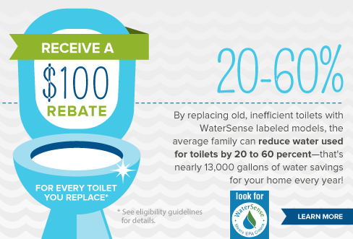
Toilet Rebate Program
$50-$100 rebates available for older toilets installed in 1993 or earlier
northgeorgiawater.org/toiletrebate
Notes:
Danny:
There are many toilet rebate programs available to homeowners across metro Atlanta.
If a home has toilets installed in 1993 or earlier, then the homeowner may be eligible for rebates ranging from $50-100
You can visit our webpage at northgeorgiawater.org/toiletrebate for more details
By replacing an old, efficient toilet with WaterSense labeled models, the average family can reduce water used for toilets by 20-60%
That’s nearly 13,000 gallons of water savings for your home every year
In DeKalb, homeowners that replace a toilet through the retrofit on reconnect ordinance, may also be eligible for a rebate.
Contact DeKalb County Watershed Management for more details on the program.

Slide 37
WaterSense Products
Showerheads
Toilets
Urinals
Irrigation controls
Sink faucets and accessories
Pre-rinse spray valves
Flushometer-valve toilets
WaterSense New Homes
Notes:
Danny: (talk about the types of products available)
EPA has two certification labeling systems for energy and water efficient products.
There is the EnergySTAR label for energy efficient products and the WaterSense label for water efficient products
The WaterSense label can be found on many of the products listed here
These products are third party tested and use 20% less water
Only WaterSense labeled toilets can be replaced through the Toilet Rebate Program
Since the plumbing code change in 2012, only WaterSense labeled toilets, urinals, faucets and showerheads can be installed in new properties.
This plumbing code change came from Governor Deal’s Water Stewardship Act to encourage water efficiency in our state
WaterSense and EnergySTAR labeled products are leading the marketplace and widely popular in Georgia and across the nation
These products save water and energy but still meet what the homeowner wants in a stylish products that meets their needs
Transition to Alan

Slide 38
Septic system maintenance
Notes:
DPH: Begin discussing indoor and outdoor maintenance
30 minutes on this section

Slide 39
Care Inside the Home
Avoid pouring fats, oils, grease, rags, and solids down the drain
The toilet is not a trash can!
Spread out water use
Additives are not needed
Notes:
DPH:
Conserve water to avoid overloading the septic tank system. Be sure to repair any leaky faucets or toilets. The extra leak will not only waste water and increase the water bill, but will add extra flow into the septic tank and keep your field saturated.
Your septic tank is not a trashcan. Do not put disposable diapers, tampons, condoms, paper towels, medications, plastics, etc. down the drain or toilet.
Just because bathroom wipes are labeled as “flushable” does not mean that they will break down. Please use the trash for these wipes.
Also, do not pour fats, greases, and harmful chemicals down the drain.
Spread out water use over the week, which means everyone in the house shouldn’t take baths and wash clothes all on the same day.
And, septic additives are not needed. Many companies try to sell products with chemicals or bacteria to help your system, but these are not recommended by DPH and may cause more problems in the future.
And remember, it is the responsibility of the homeowner to maintain, repair, or replace all components of the septic system so that it protects the environment and public health.
Just like all major systems in your home including the air conditioner, electric wiring and dishwasher, if you own the home, you own those items, also. If it breaks, you fix it.

Slide 40
Care Outside the Home
Have your system pumped every 3-5 years
Do not plant, park or build on top of the drainage field
Divert downspout water away from septic system
Notes:
DPH:
Have your tank pumped and the system inspected every three to five years by a licensed septic tank contractor.
Learn the location of your septic tank and absorption field. Keep a sketch of it handy for service visits.
Don’t allow anyone to drive or park over any part of the system or put any foundational structures on the septic tank or field.
The area over the absorption field and tank should be left undisturbed with only mowed grass cover. Roots from nearby shrubs or trees may clog and damage your drain line.
Divert roof drains and surface water flow away from the septic system.
Do not make or allow repairs to your septic system without obtaining the required health department permits. Use licensed septic contractors only.
Assure the appropriate maintenance agreement and/or extend the service policy for ATU Units (Aerobic Pretreatment Tanks), if installed. Contact the manufacturer of the unit or County Environmental Health for more information

Slide 41
Septic vs. Sewer Cost Comparison
Septic system:
System installation and regular maintenance
Sewer system:
Initial connection and monthly consumption charges
Septic vs. Sewer Monthly Costs
Regular Septic Maintenance | DeKalb County Sewer Bill
Average pump out: $300-$500 Frequency: every 3-5 years | Base Fee: $6.90 Consumption Charge: ≥ $11.34
≈ $8.33 per month | ≈ $18.24 per month in lowest tier
Notes:
DPH:
We have discussed many of the benefits of septic, but also addressed what can happen if there is a failure or poor performance.
Let’s compare what we know about septic with local municipal sewer in our area.
Does anyone have an idea of how much it might cost to connect to the sewer system?
In DeKalb County, if sewer is available, it costs about $1800 to connect to the sewer line, not including the labor costs of a plumber and obtaining a plumbing permit.
As you know, once the sewer is connected, there is a monthly charge based on the consumption.
In comparison, it costs thousands to install a new septic tank and drain lines.
However, once a septic tank is installed, there is no monthly charge like a sewer bill, but as we mentioned before it is important to maintain the septic system and have it pumped every 3-5 years.
If we look at the cost of an average pump out and divide it over 3-5 years we see that each month it’s about $10 less to have septic and maintain it frequently compared to DeKalb County’s sewer charges
At the lowest sewer consumption of 4,000 gallons per month or less, the homeowner is paying about $18 per month
So it’s easy to think about it like putting a $10 bill in an old coffee can each month and setting that money aside for the next pump out.

Slide 42
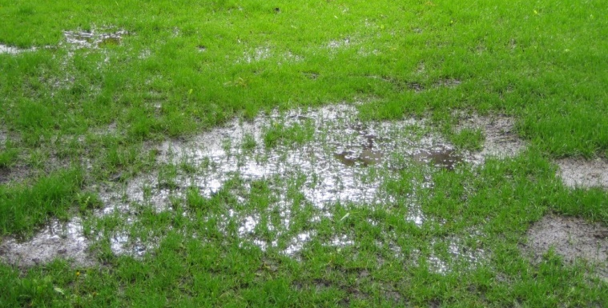
Warning Signs
Very green grass above drainfield, even during dry weather
Wet, soggy grass
Strong odors around tank
Slow, clogged drains in the home
Notes:
DPH:
- Soil type, water conservation, and quality of maintenance will determine the life expectancy of any septic tank system.
One warning sign is very green grass above the drainfield, even in dry, cold weather when the rest of the lawn isn’t as green.
Follow your nose. The most obvious evidence is wet areas on your property having a sewage odor that are located above the absorption field. This will occur for many reasons and indicates that the system needs replacement.
Other premature indicators are water backing up in the house or slow flushing toilets.
If the drain in the second floor bathroom is backing up, but all the drains on the first floor seem fine, chances are it is due to a clog in the internal plumbing of the house.
If the backup is at a lower elevation or is the closest drain to the septic tank, then the issue may be with the septic system.
Contact a plumber to evaluate your situation.
If you have concerns that your septic system is failing, contact a licensed septic tank contractor.
Remember to contact county health department before having any repairs made, because a repair permit is needed on file.

Slide 43
Implications of Septic Tank Failures
Inoperable drains
Septic tank overflow and water contamination
- Nearby streams or lakes - Local water supply
- Well water - Neighbor’s wells
Drainage field or septic system may need replacement
Notes:
DPH:
If the septic tank does fail and the homeowner does not make repairs, there are some major implications on the water quality and public health.
If these problems are not repaired, then the county health department will come in and try to work with the homeowner. If this does not work, the home could eventually become condemned.
Transition to discuss resources

Slide 44
Resources
www.cleanwatercampaign.org/septic
Certified List of Installers, Pumpers or Soil Classifiers
County Environmental Health Offices
How to Find Septic System Records
Notes:
Danny: Go over the resources available and recommended use

Slide 45
Notes:
Danny: review the homeowner’s guide

Slide 46
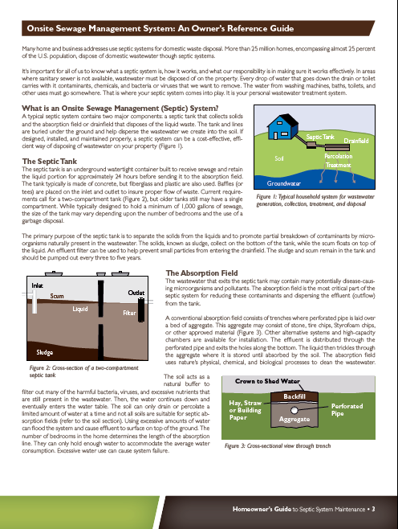
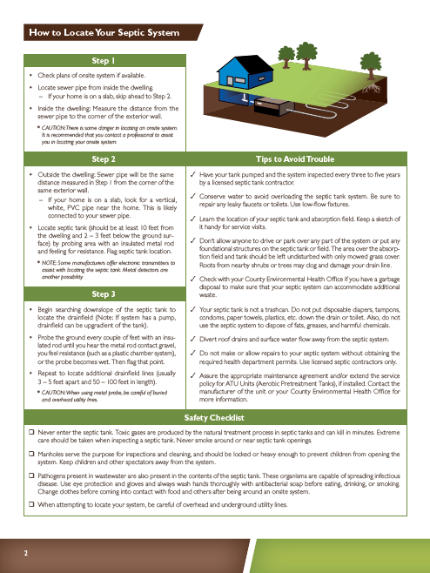
Notes:
Danny

Slide 47
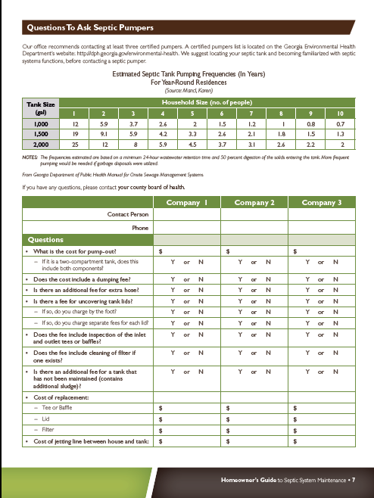
Notes:
Danny

Slide 48
Summary
Septic systems are an underground wastewater structure
Locate the system and maintain records
Do not build, park or plant on septic tank or drainfield
Additives are not necessary
Notes:
Danny:
There are many homes on septic in metro Atlanta
We estimate there are almost half a million homes on septic in the 15 county area
The septic tank is an underground watertight container built to receive sewage
The tank and lines are buried under the ground and help disperse the wastewater we create into the soil.
It’s important to know the location of the system and maintain good records
There are traditional and advanced treatment systems, contact your county environmental health department for septic system records
If it’s an advanced treatment system, there is a maintenance agreement for the first three years and should be continued by the homeowner
Remember to not build or park cars on the system and additives to the system are not necessary!

Slide 49
Summary
Maintenance recommended every 3-5 years
Problem signs include:
- Strong odors - Wet, soggy grass
- Very green grass - Clogged drains
Recommend a state certified contractor
Notes:
Danny:
A septic system should be pumped every 3-5 years
It costs less than $10 per month over the cost of 3-5 years to pay for an average pump out
You may recognize a problem if you smell strong odors, notice soggy or very green grass, or if there are clogged drains or backups in the house
Call a certified septic contractor for an inspection before the problem continues
It’s important to know that a failing septic system can lead to water quality and public health concerns if the problem is not fixed

Slide 50
Summary
Avoid pouring fats, oils, grease, rags, and solids down the drain
Local governments have ordinances and protections for water quality and conservation
WaterSense products and rebate programs can help save money!
Notes:
Danny:
Remember the toilet is not a trash can and fats, oils, grease, rags, etc. do not belong down the drain
Keep in mind that local governments have ordinances and buffers in place to protect water resources
WaterSense products help save money and save water and reduce the burden on your drainfield.
There is likely a rebate program available and you can find out more details on our webpage

Slide 51
Like Us on Facebook
Metropolitan North Georgia Water Planning District
Follow us on Twitter
@NorthGAWater
Follow us on Instagram
@NorthGAWater
Notes:
Danny – share social media outlets

